Slide 1

Welcome!

Slide 2
Protecting public health
Council of Europe and its European Directorate for the Quality of Medicines & HealthCare (EDQM)
Suzanne HENDERSON

Slide 3

Agenda
Protecting public health: the Council of Europe and its European Directorate for the Quality of Medicines & HealthCare (EDQM)
The role of scientific programme managers in three EDQM departments
Application and recruitment process

Slide 4


The EDQM, a Directorate of the Council of Europe
Council of Europe
▶ Founded in 1949
▶ Intergovernmental organisation, Strasbourg
▶ 46 member states
▶ More than 700 million citizens
EDQM
▶ Founded in 1964
▶ Works in the framework of a partial agreement, 39 members & the EU
▶ Contributes to public health and access to good quality medicines and healthcare in Europe

Slide 5
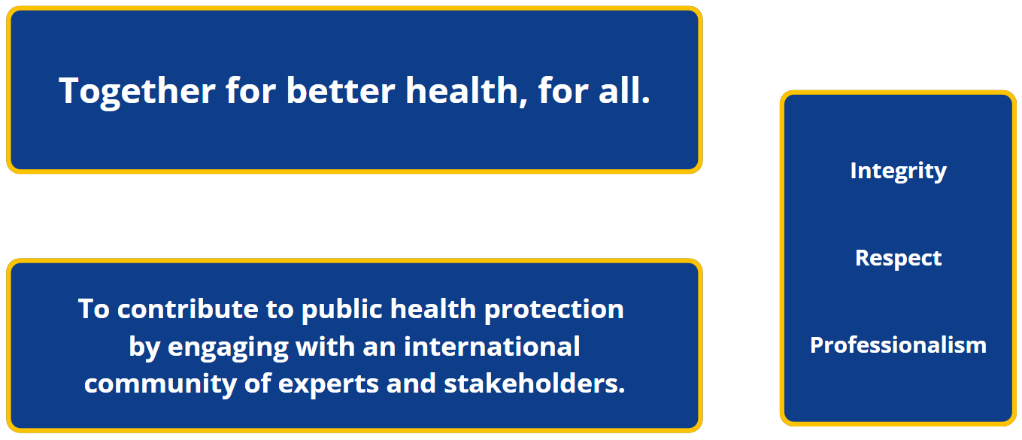
What we stand for
Mission
Values
Vision

Slide 6

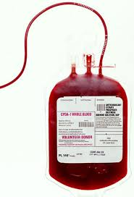



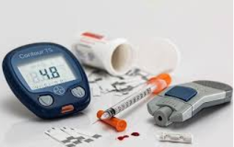




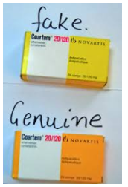

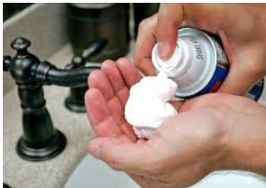



Is the relevant for you?
we think so…

Slide 7
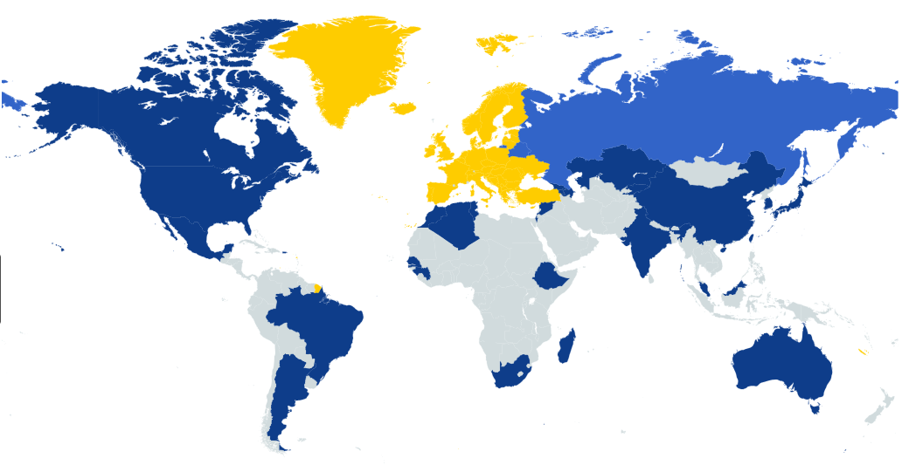
EDQM, in Europe and beyond
The European Pharmacopoeia
  European Pharmacopoeia members
  European Pharmacopoeia observers
  EDQM, 39 member states & the EU

Slide 8



Key figures
  Areas of work
  Administrative entities
Medicinal products
Substances of human origin
Pharmaceutical care
Consumer health
More than 400 staff members 26 nationalities and dozens of different professions
Working with a global network of almost 2 000 experts from a wide variety of scientific disciplines
5 intergovernmental committees
1 treaty-based body (EPC)
2 steering committees (BSP, CEP)
3 networks
More than 100 expert groups
  Sites

Slide 9

What jobs do we need to fill?
European Pharmacopoeia Department
Laboratory Department
Certification of Substances Department

Slide 10
The role of scientific programme managers
in the European Pharmacopoeia Department (EPD)
Amela SARAČEVIĆ

Slide 11

Amela Saračević
Scientific Programme Manager
in the European Pharmacopoeia Department (EPD)
Joined the EDQM in 2014, and EPD in 2017

Slide 12
EPD
European Pharmacopoeia (Ph. Eur.):
  A set of official standards providing a legal and scientific basis for the quality control of medicines and their ingredients
  A part of the European regulatory framework that ensures medicines are safe and of good quality
  Widely used and internationally recognised
International harmonisation with other major organisations
Working with experts from regulatory authorities (national pharmacopoeia authorities, official medicines control laboratories, licensing authorities), academia and the pharmaceutical/chemical industry, from across Europe and beyond

Slide 13
The team
About 50 people in EPD, with scientific and administrative functions
Division A - Chemically Defined Substances, Finished products, General Chapters & Herbals - team of 16 people

Slide 14
My role in EPD
manage different groups of experts and collaborate closely in technical discussions that help us shape our state-of-the-art monographs
evaluate scientific data, support and co-ordinate scientific elaboration, verification, revision and validation of analytical procedures in (new) monographs
collaborate with internal and external laboratories preparing detailed study requests and making sure that analytical testing is performed in a timely manner
draft Ph. Eur. texts (monographs and general chapters) in close co-operation with experts in the field, based on scientific data

Slide 15

Working in EPD
Dynamic environment with great teamwork and collaboration, both internally and externally
Scientific knowledge and joint efforts are key elements behind every pharmacopoeial text

Slide 16
The role of scientific programme managers
in the Laboratory Department (DLAB)
Jochen PAUWELS

Slide 17
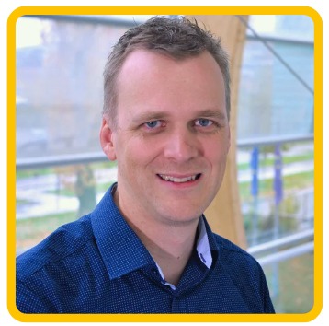
Jochen Pauwels
Head of the Analytical Chemistry Division
in the Laboratory Department (DLAB)
Joined the EDQM in 2012

Slide 18









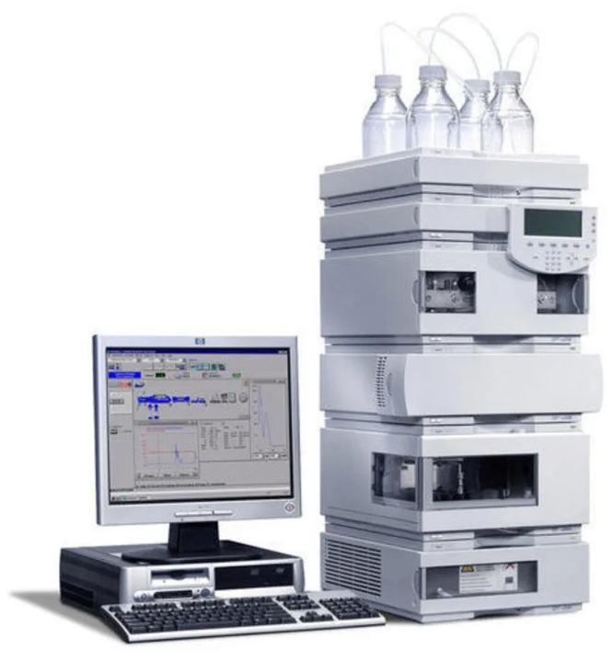


The workplace
Organisation
Activities
EDQM Laboratory (DLab)
53
Reference standards
Analytical procedures
Analytical instruments
36
11
Analytical Chemistry Division
Biology Section
8
26
Scientific
programme managers
Lab technicians

Slide 19



The job
Network
People management
Scientific programme manager
Project management
Lab study management

Slide 20
The role of scientific programme managers
in the Certification of Substances Department (DCEP)
Andrea MELLONI

Slide 21
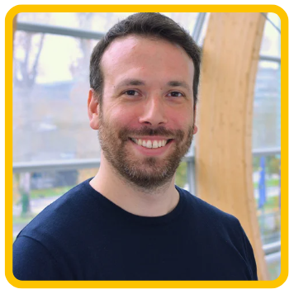
Andrea Melloni
CEP Assessor
in the Certification of Substances Department (DCEP)
Joined the EDQM in 2020

Slide 22
Certification of Substances Department (DCEP)
DCEP runs the procedure for the certification of suitability to the monographs of the European Pharmacopoeia (CEP).
The mission of the CEP procedure is to:
assess and conclude on the suitability of monographs to control the chemical purity, microbiological quality and TSE risk (if relevant) for any substance covered by a European Pharmacopoeia monograph;
check compliance at the manufacturing and/or distribution site(s) covered by certificates of suitability to the monographs of the European Pharmacopoeia (CEPs) with both:
  Good Manufacturing Practice (GMP) for medicinal products for human or veterinary use, and the
  CEP granted according to the information submitted in the application(s) for CEP(s).

Slide 23

The team
Over 50 people in DCEP: assessors, inspectors, scientific and administrative staff
The New Dossier Evaluation Section is composed of 11 senior assessors, in charge of the assessment of CEP applications (chemical, herbal, TSE, sterile)
We work with many other teams, both in DCEP and across the EDQM

Slide 24
The job
CEP assessors:
conduct, co-ordinate or contribute to thorough and timely investigations into quality issues that impact the validity of CEPs
participate in the scientific assessment of data related to CEP applications in accordance with relevant rules and guidelines
collaborate with expert assessors from national competent authorities for the review of applications

Slide 25


Why I like the job and you might too….
CEP assessors play a key role in the protection of public health and quality of medicines by facilitating and simplifying exchanges between regulators and industry
Working with about 100 assessors from 25 countries, including Australia and Canada, and health authorities is enriching and stimulating
Being an active part of an international organisation that promotes scientific excellence and development is empowering and exciting
Notes:
CEP assessors play a key role in the protection of public health and quality of medicaments by facilitating and simplifying exchanges between regulators and industry to ensure that the quality of substances used in the production of pharmaceutical products is guaranteed and that these substances comply with the European Pharmacopoeia and therefore with the requirements of the relevant EU legislation.
The close collaboration with about 100 assessors from 25 countries, including Australia and Canada and health authorises is enriching and stimulating, as well as being an active part of an international organisation who promotes scientific excellence and development.
Knowing that I am being part of the future of the public health and that I am protagonist in the future challenges of the pharmaceutical world confirms to me every day that choosing to become an EDQM assessor was the right choice for my career.

Slide 26
Application and recruitment process
What to keep in mind

Slide 27
Our ideal candidates (1/2)
  Education: bachelor / master’s degree in pharmacy, chemistry, or similar
  Experience:
  quality control of substances for pharmaceutical use and/or medicinal products
  developing/verifying methods of analysis for substances
  preparing/evaluating Module 3 of the Common Technical Document (CTD)
  Previous employers
  licensing authorities or an official medicines control laboratory
  pharmaceutical or other relevant industries
  University, e.g. during PhD studies, or
  a national or international institution

Slide 28
Our ideal candidates (2/2)
  Your other skills :
  analytical mindset but also a good problem solver, who evaluates issues and challenges and then proposes and implements solutions
  excellent planner: able to co-ordinate several projects simultaneously to meet deadlines
  continuous improvement mentality: evaluates and adapts current methods and procedures to get better results
  effective communicator: clear and logical in both written and oral communication with a very good level of English and the ability to learn French
  team player: builds and sustains positive working relationships with others to ensure the work gets done
  great networker: develops and maintains networks of contacts in and beyond the EDQM

Slide 29
Application form and shortlisting
check “Your role”, “What we are looking for” in the advert
check the “you must” part of the advert and clearly explain in your application:
  your qualifications and how they match what we are looking for
  how your experience corresponds to what we need
  your language skills
  relevant training and publications – only list relevant ones
  that you know who you are applying to, i.e. not the EU!!!
we may use the “may be an asset” to refine numbers invited for tests
Shortlisted → testing

Slide 30
Tests
  compulsory
  relevant to the job
  may include other elements such as project/people management/client service
  written
  online
  in English (for scientific jobs)
  papers will show the weighting of parts of the test
  pass mark is usually 50%
  passing the tests → pre-selection list

Slide 31
Pre-selection list and interview
Pre-selection list
  valid for up to 4 years
  can be used by all EDQM teams not just the ones you applied for
  you can refuse a job offer and remain on the list
Interview
  recruiting teams screen the pre-selection list
  invite between 3-5 for each role
  onsite or via Teams
  potentially, a specific test prior to interview with oral presentation
  competency based interview – STARS
  language requirements tested

Slide 32
Offer
  basic salary stated on vacancy notice - maybe slightly higher depending on experience
  fixed and equitable salary system - no negotiation of salary
  before formal offer can be made
    allowances will depend on personal circumstances – form to be completed
    copies of qualification – need a translation if not in English or French
    the quicker you provide information the quicker we can be
  you have 10 days to accept the written offer

Slide 33
Your contract
  first contract – max 1 year = probationary period
  renewable for further 3 years
  at 4 years, if:
  we have the funding,
  we need the role, and
  you have demonstrated the competencies needed
  ...we will offer you an open-ended contract

Slide 34

The recruitment process
Shortlisting
Testing
Interview
Offer
Usually 1-2 weeks after closing date
e44 due to winter holidays - beginning of January 2024
Usually 3 weeks after the shortlisting completed
e44 – end of January 2024
Usually within 4-6 weeks - potentially anytime in 4 years
e44 Feb/March 2024
Orally within 1-2 weeks of the interview
Closing date
7 December
Arrival

Slide 35








Why join the EDQM team?
International environment
Flexible working / teleworking
Highly scientific environment
Attractive pension & tax-free salary
Learning & development
Holidays, wellbeing & life-work balance
Attractive healthcare policy & insurance
Sustainable working environment

Slide 36
I am interested but, I am hesitating
You having nothing to lose.
In addition, other roles may come up across the organisation
in the next few years,
so, get yourself on a
“pre-selection” list by applying now!
European Pharmacopoeia Department
drafting European Pharmacopoeia texts using scientific data and other information available e.g. batch data, validation protocols and reports
co-ordinating the work programme of subject matter experts from across Europe and beyond
Laboratory Department
managing laboratory projects related to the establishment and maintenance of European Pharmacopoeia reference standards
verification and/or development of analytical procedures to define qualitative and quantitative attributes of substances, preparations etc
Certification of Substances Department
participating in the scientific assessment of data related to CEP applications
conducting, co-ordinating or contributing quality investigations that impact the validity of CEPs

Slide 37
Notes:
On behalf of EDQM and our presenters, thank you for joining us today, and have a great rest of your day!

